Slide 1

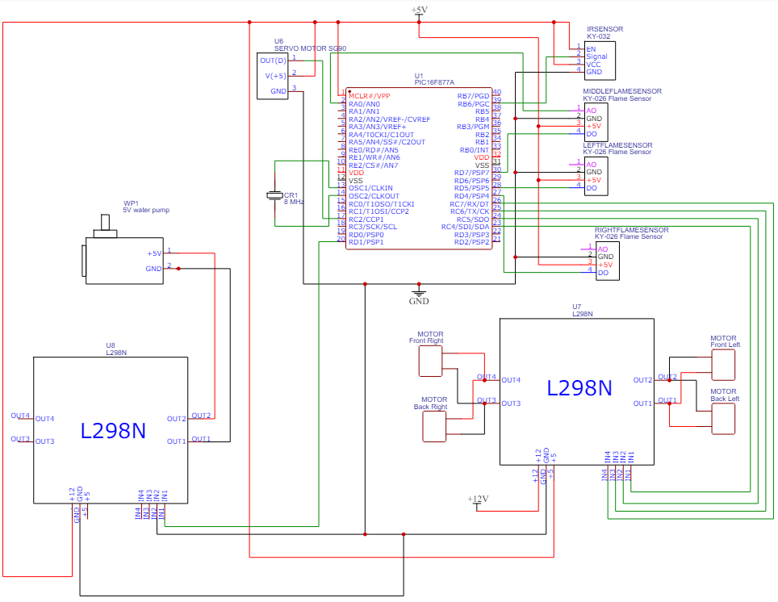
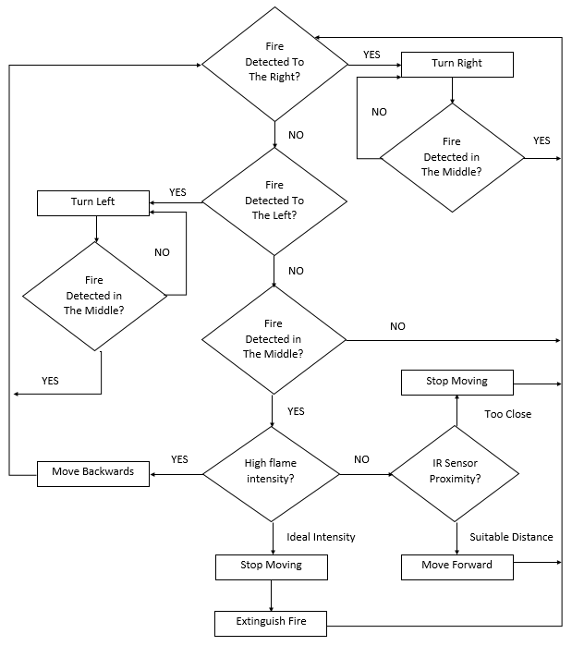
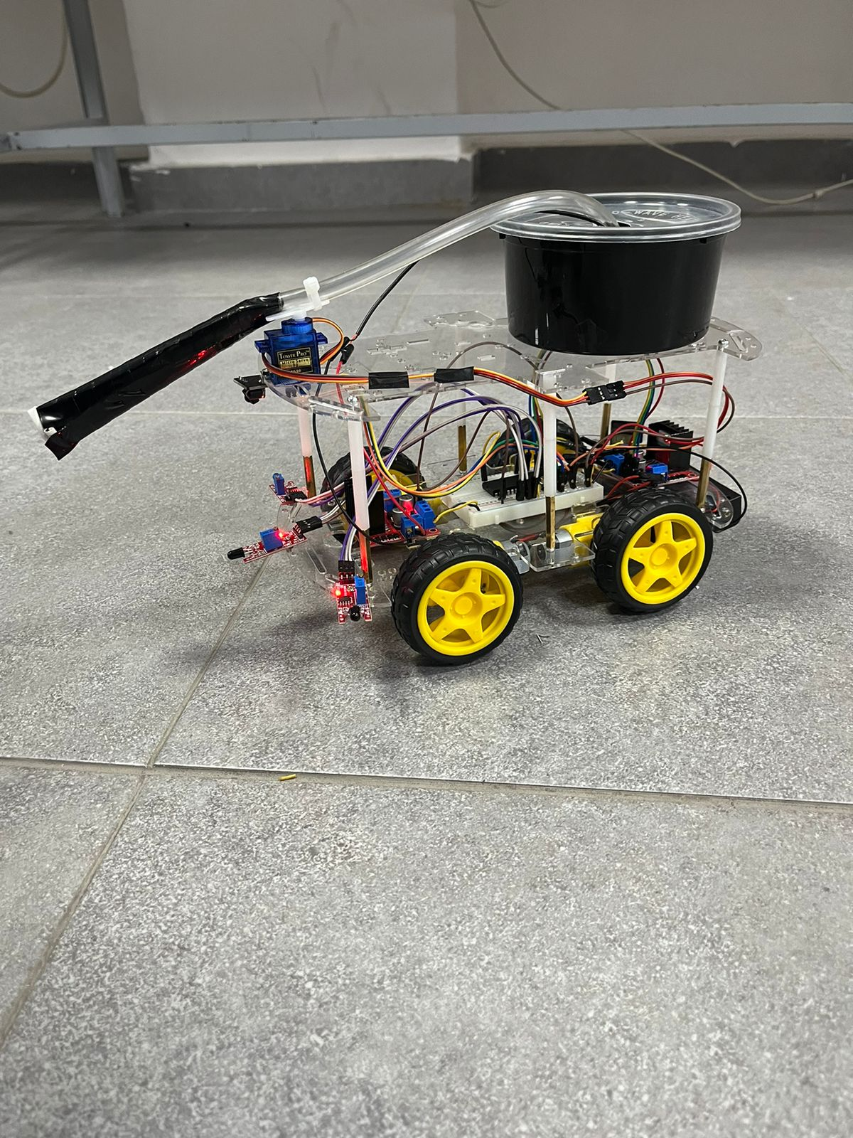
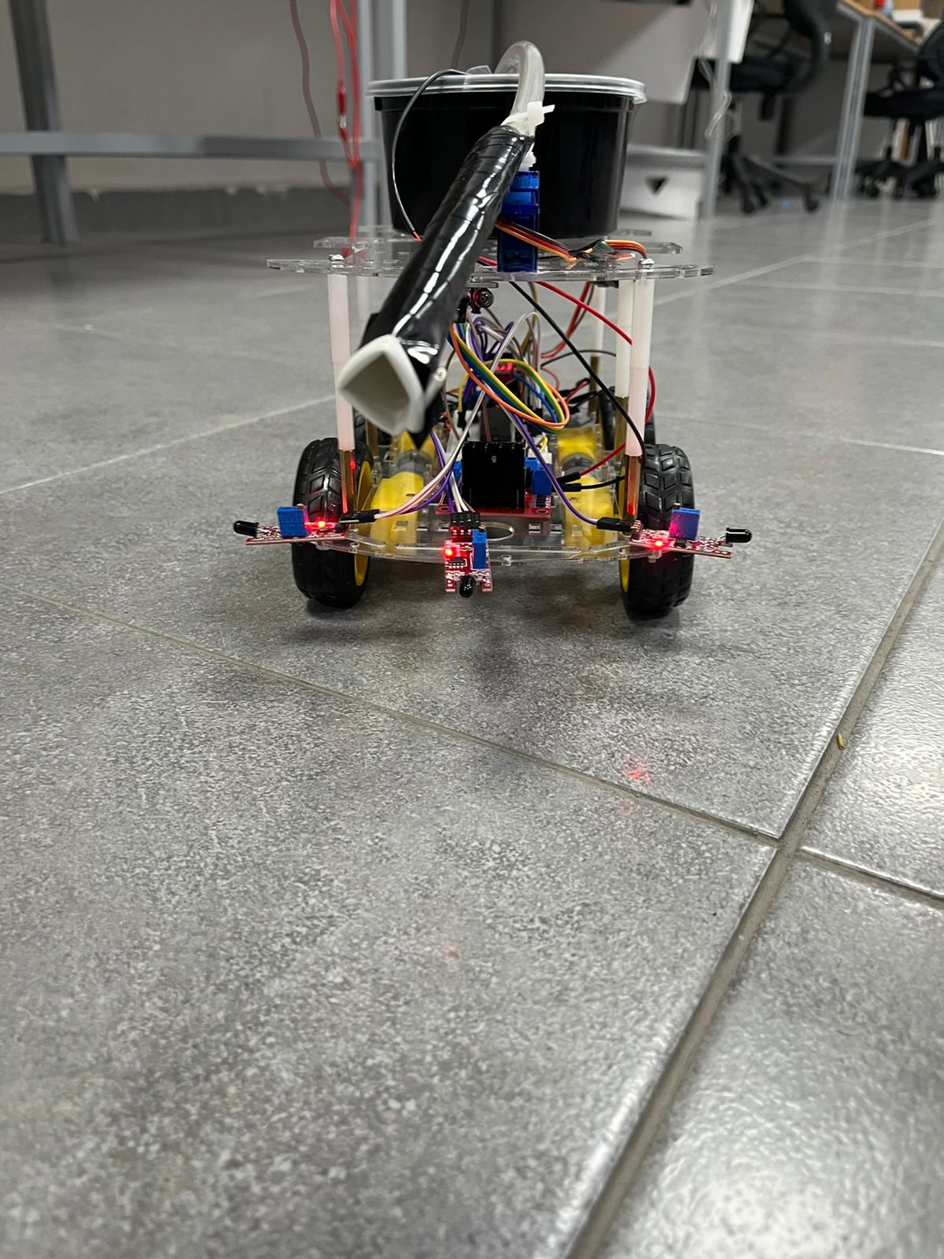
Autonomous Firefighting Robot
K. Kawar, O. Asad, and O. Al-doulat
Supervisor: Dr. Anastasia Gharib
Embedded Systems Final Design Project, Spring 2024
King Abdullah II School of Engineering
Princess Sumaya University for Technology
Introduction
In this project, we developed a firefighting robot that can detect and approach fires for quick extinguishment. The robot uses a system of three flame sensors positioned at the front to accurately locate fires and an IR sensor for obstacle avoidance. Its motors are controlled by an H-bridge connected to a 12V battery, ensuring smooth movement. The robot has another H-bridge to manage the water pump, which is powered by a separate 5V battery, and a servo motor to control the direction flow of the water, it also features a compact water tank and a pump, all controlled by a PIC16F877A microcontroller.
Figure (2): Hardware Design
Results
Figure (3): Side View Figure (4): Front View
Design
Figure 1: Software Design
Conclusion
Overall, embedded systems have proven to be very effective and convenient. Our project successfully met its goal by detecting fire and extinguishing them with a water pump. The robot autonomously detects and extinguishes small fires, enhancing safety in controlled environments. This integrated approach ensures that our robot can swiftly respond to fire incidents, providing a reliable and autonomous solution for firefighting tasks. The project highlights the broader significance of embedded systems in improving safety and operational efficiency.

